Slide 1
Lending Club Case Study
Loan Performance Analysis & Recommendation
Prepared by:
Rahul Udayshankar Sinha
simplyrahul@gmail.com
Sinchan Sen
sinchan1984@yahoo.co.in

Slide 2
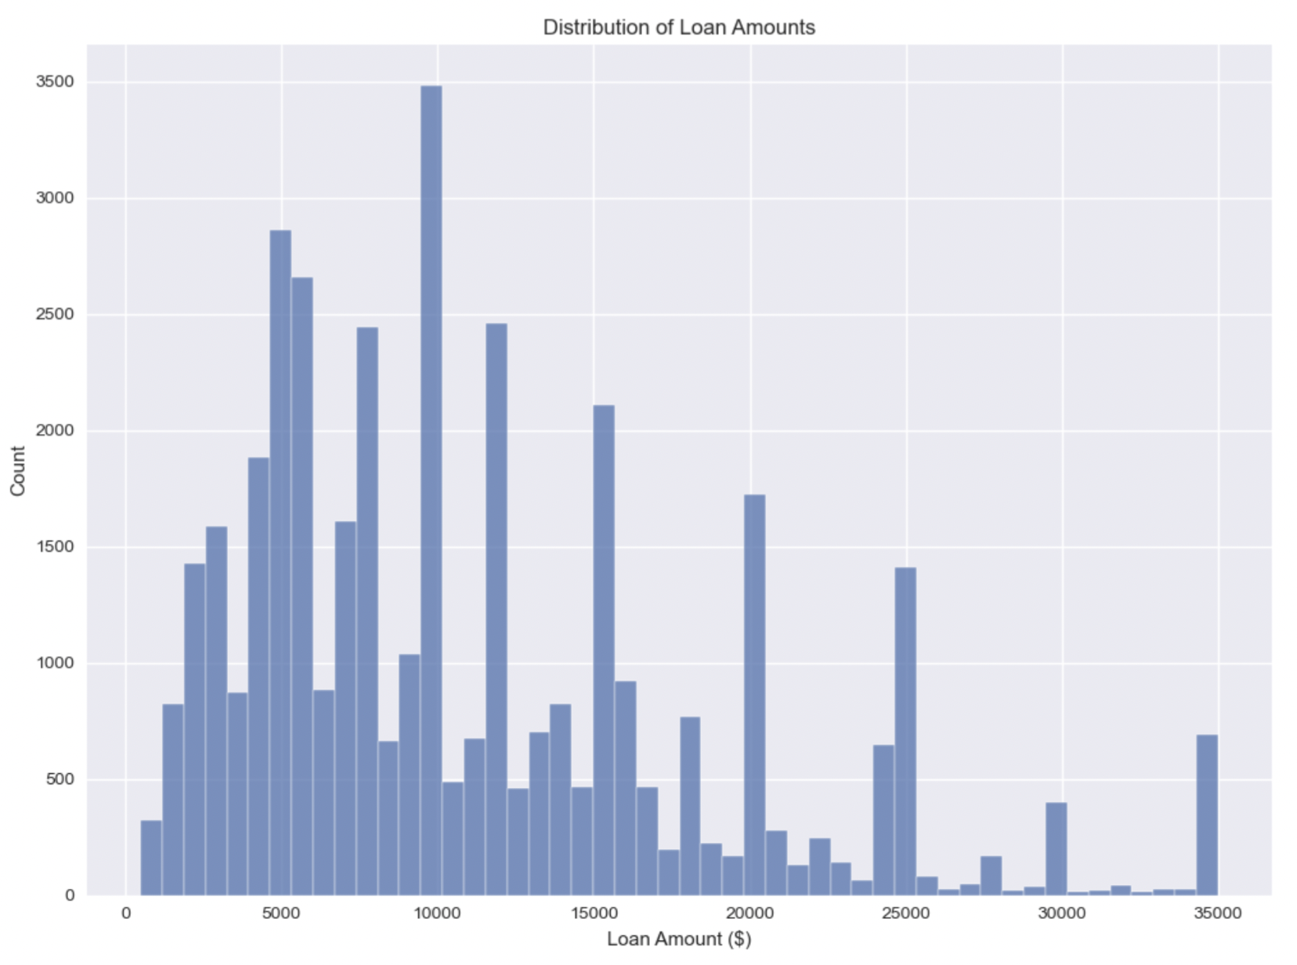
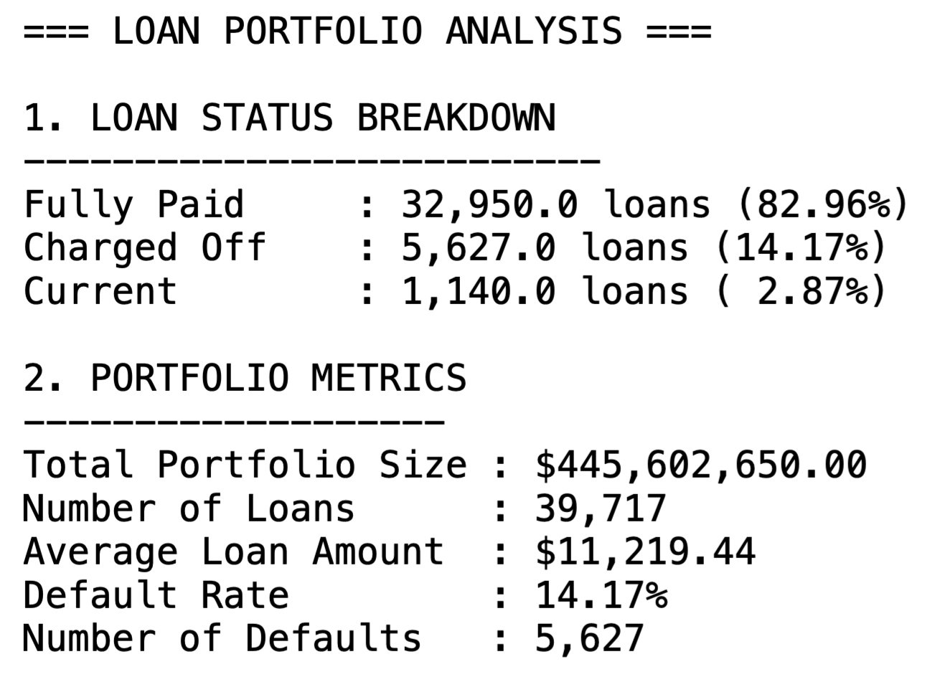
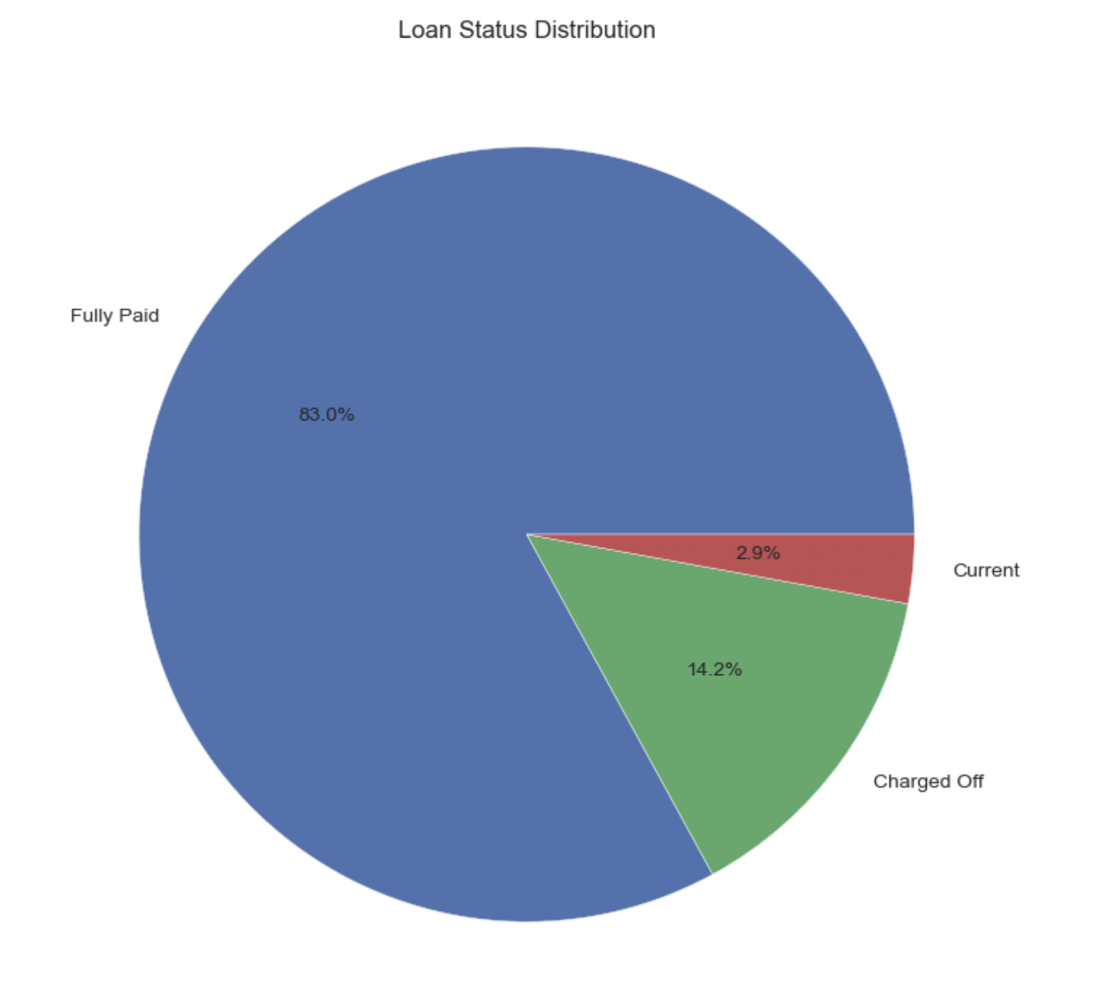
Portfolio Composition
Loan Portfolio Metrics
- $445.6M Total Portfolio Size
- 39,717 Active Loans
- 14.17% Overall Default Rate
- 82.96% Successfully Paid

Slide 3
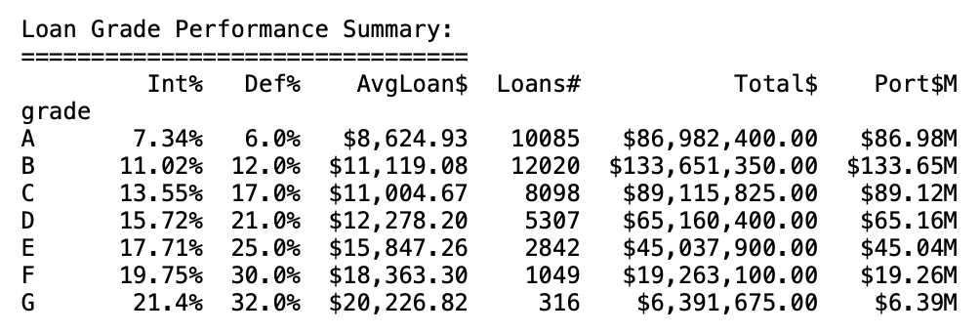
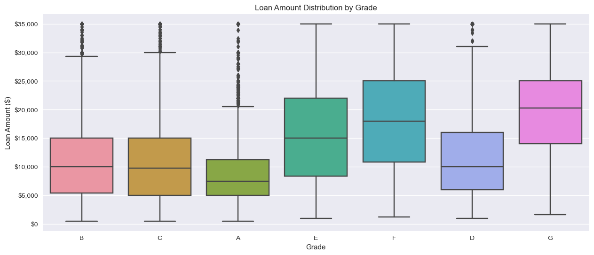
Risk-Return Analysis
Grade Performance Summary

Slide 4
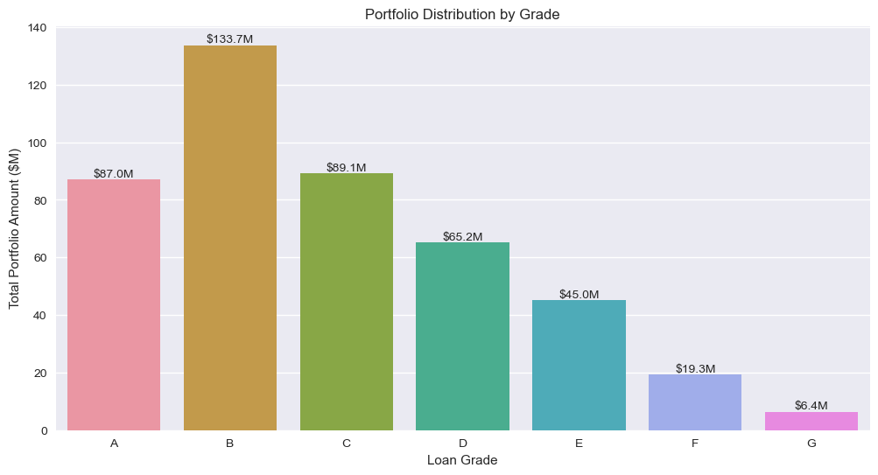
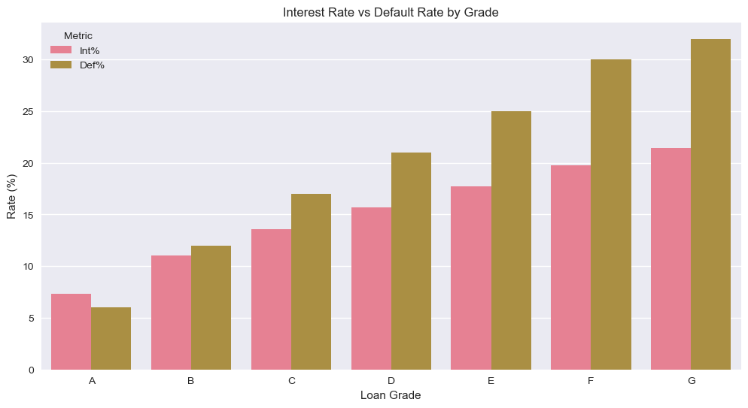
Portfolio Composition
Grade Distribution
- Grade A: 25.39% | $86.98M
- Grade B: 30.26% | $133.65M
- Grade C: 20.39% | $89.12M
- Grade D: 13.36% | $65.16M
- Grade E-G: 10.60% | $70.69M

Slide 5
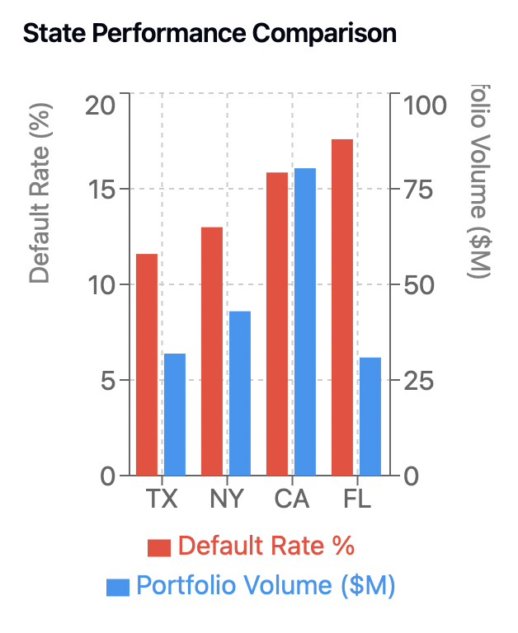
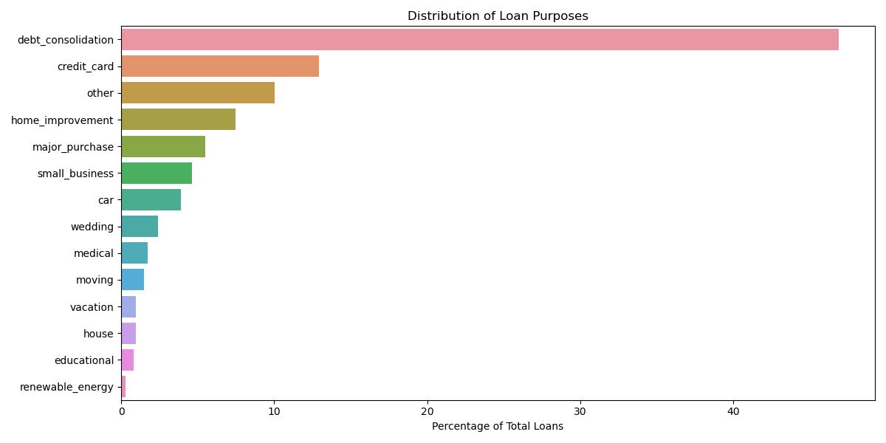
Loan Distribution Analysis
Loan Purpose Distribution
TOP Markets by Geography
1. Debt Consolidation: 46.93%
2. Credit Card: 12.92%
3. Other: 10.05%
4. Home Improvement: 7.49%
1. California: $80.4M | 15.85% Default
2. New York: $43.0M | 12.99% Default
3. Florida: $30.9M | 17.59% Default
4. Texas: $31.9M | 11.59% Default

Slide 6
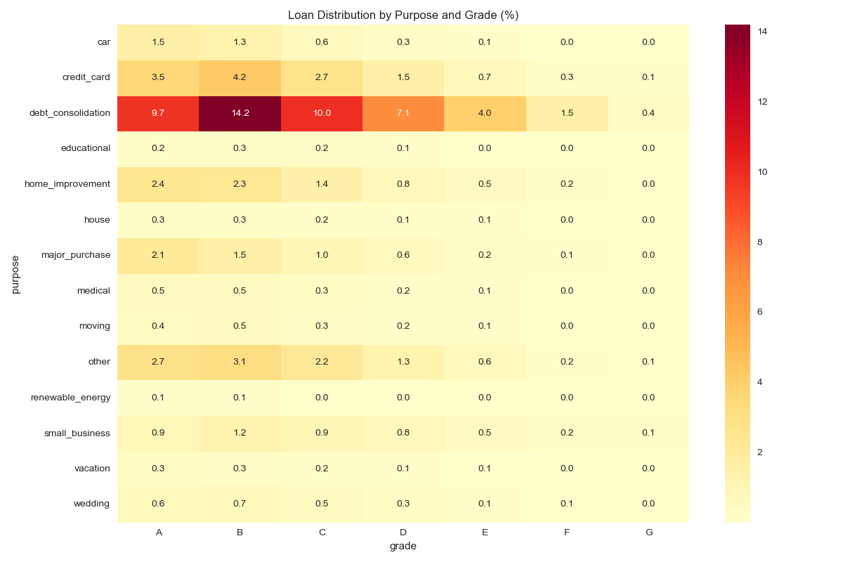
Loan Distribution Analysis
Loan Distribution - Purpose & Grade
1. Debt Consolidation: 46.93% - Grade A to C - 33.9%
2. Credit Card: 12.92% - Grade A to C - 10.4%
3. Home Improvement: 7.49% - Grade A to C - 6.1%

Slide 7
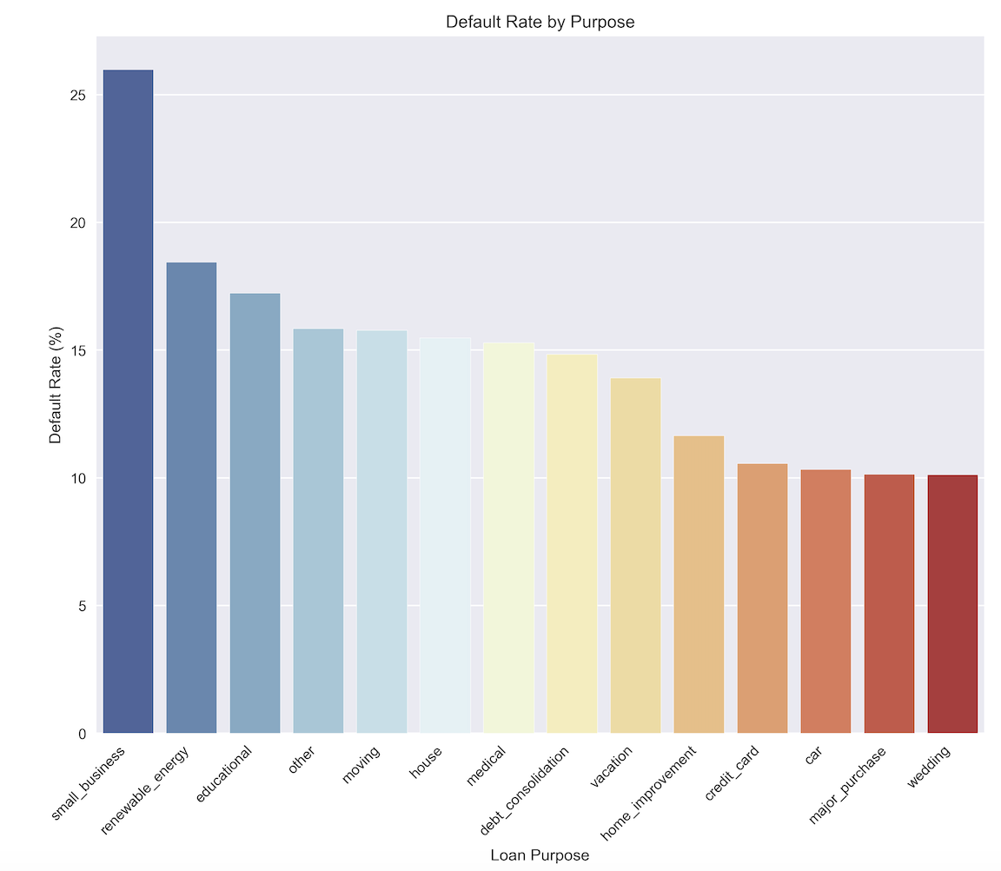
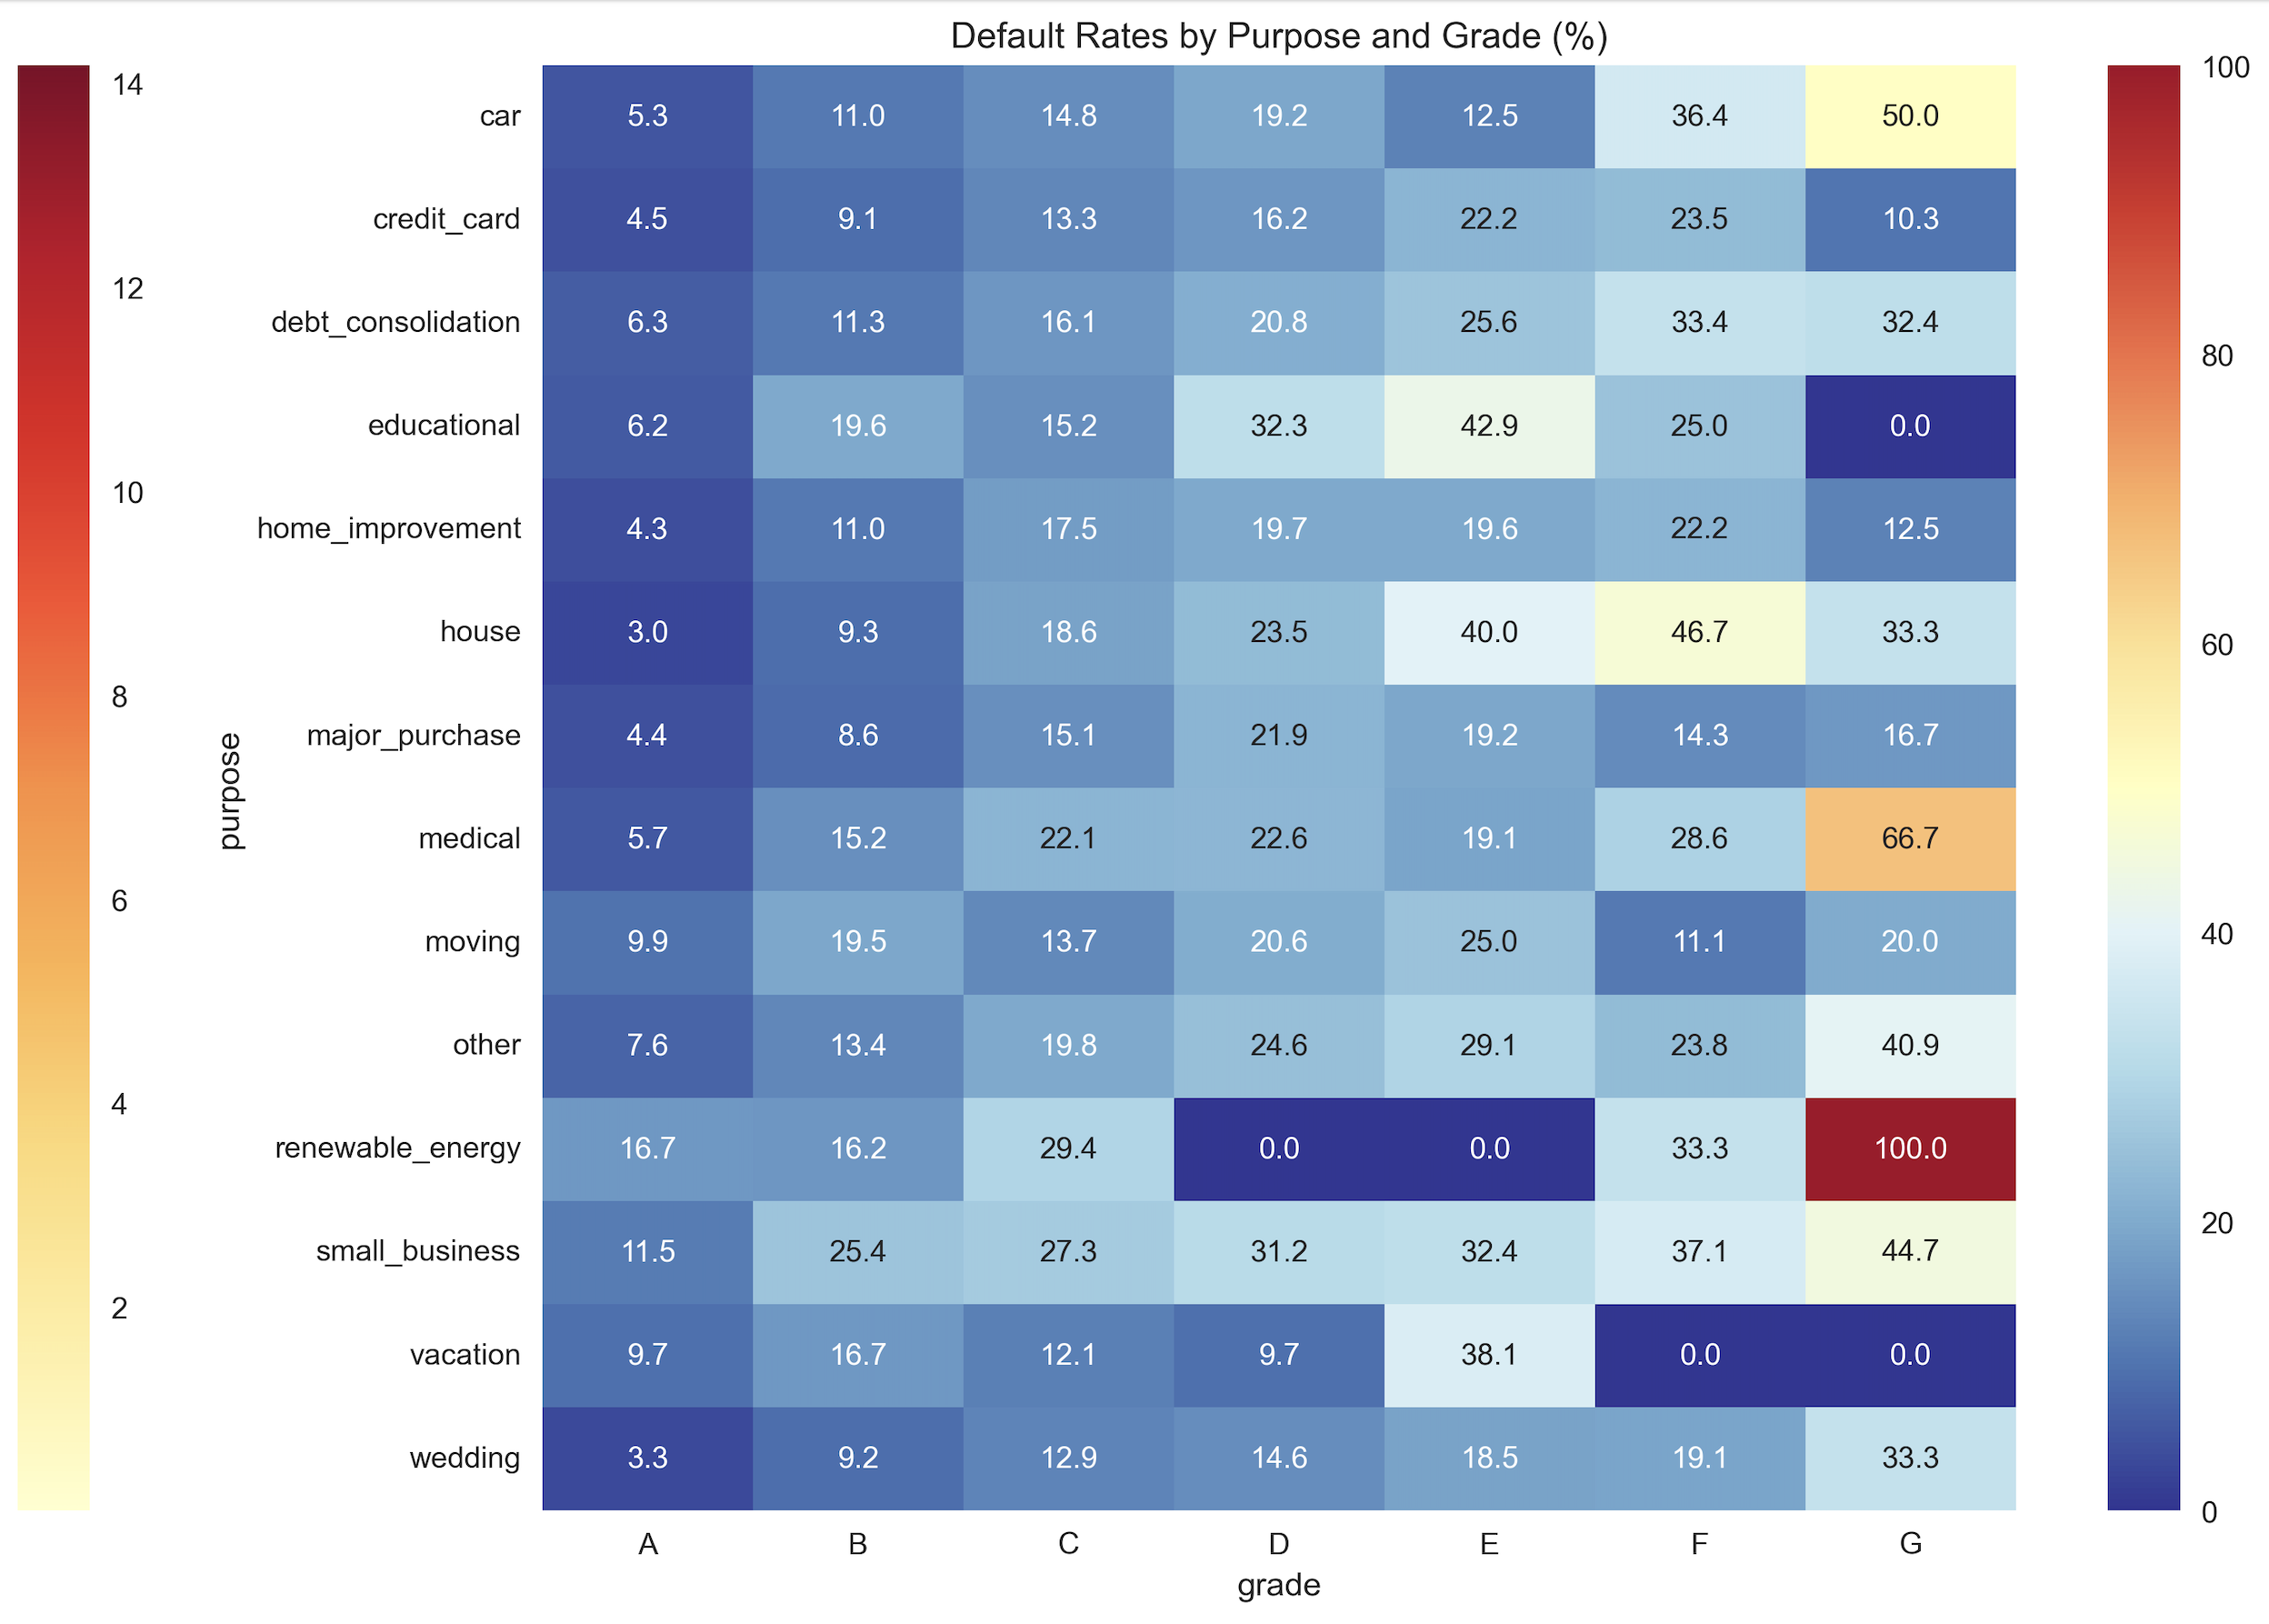
Loan Default Analysis
Default Rates by ”Purpose”
Highest Risk:
- Small Business: 25.98%
- Renewable Energy: 18.45%
Lowest Risk:
- Wedding: 10.14%
- Major Purchase: 10.15%

Slide 8
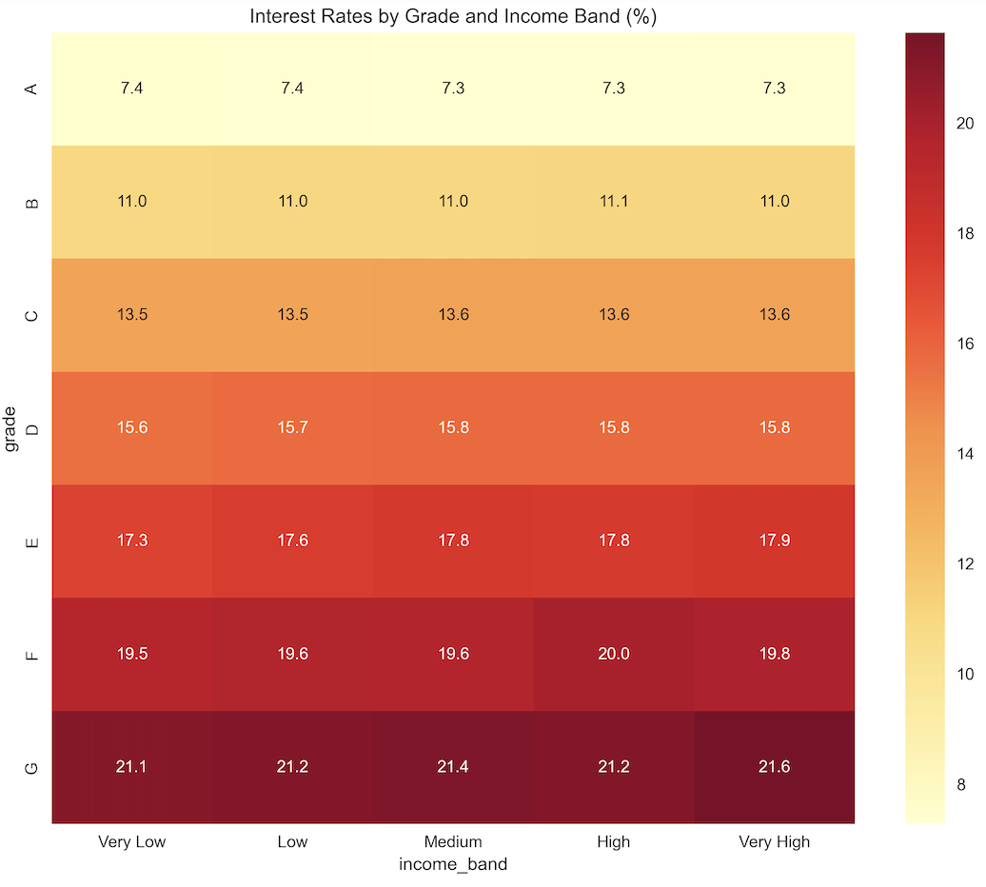
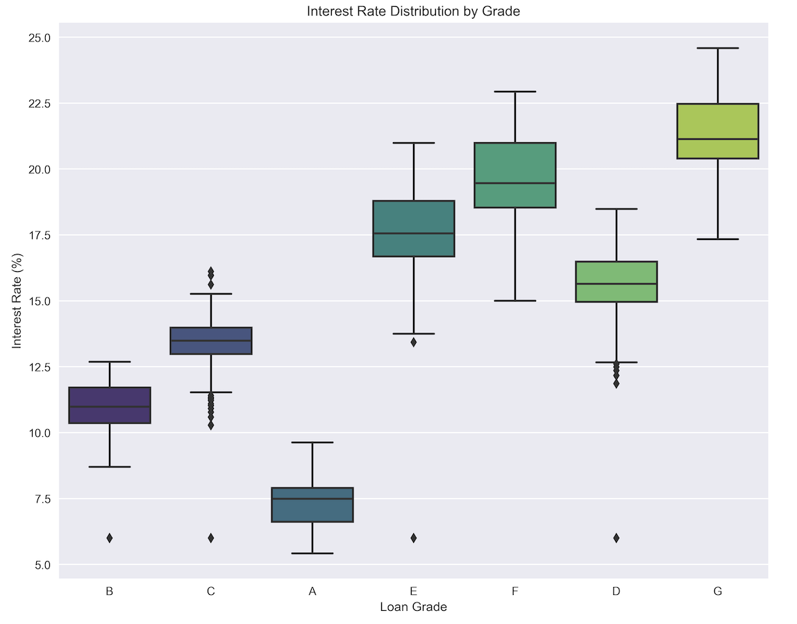
Interest Rate Analysis
Interest Rates by Income & Grade
- Grade A, High Income: 7.34%
- Grade A, Low Income: 7.41%
- Grade G, High Income: 21.64%
- Grade G, Low Income: 21.13%

Slide 9
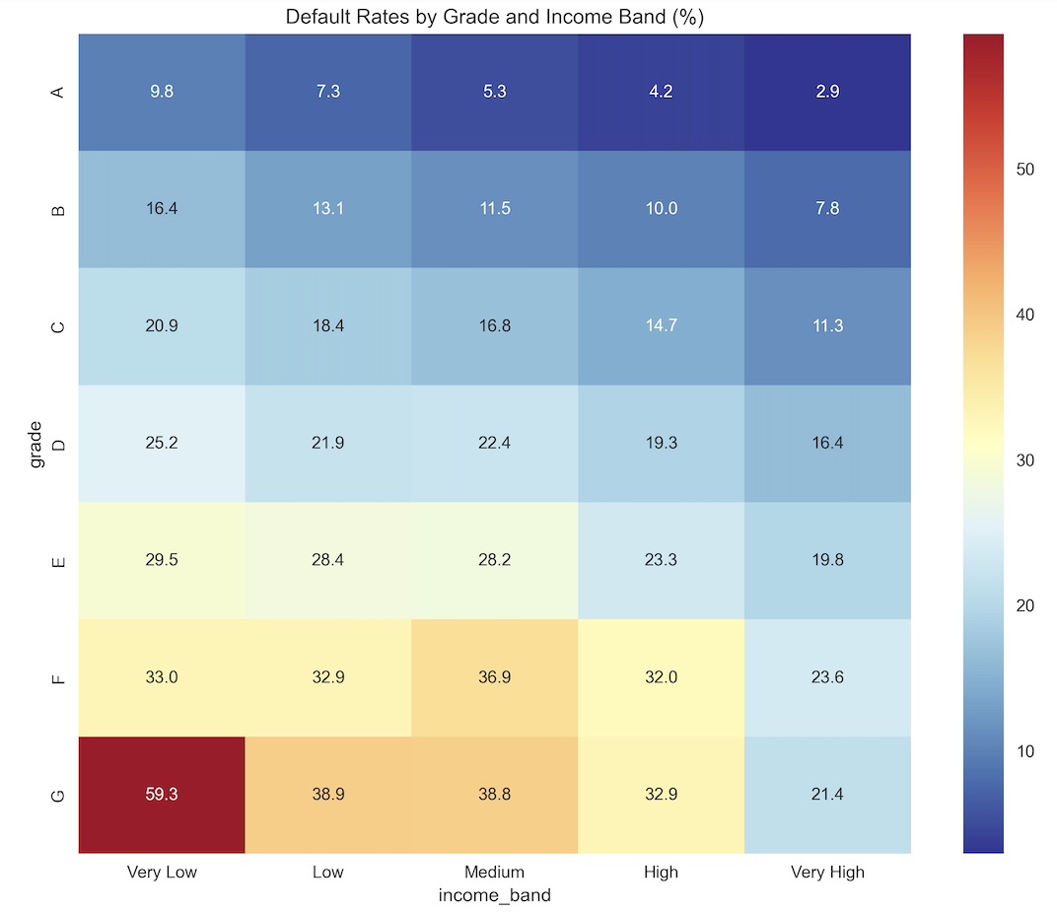
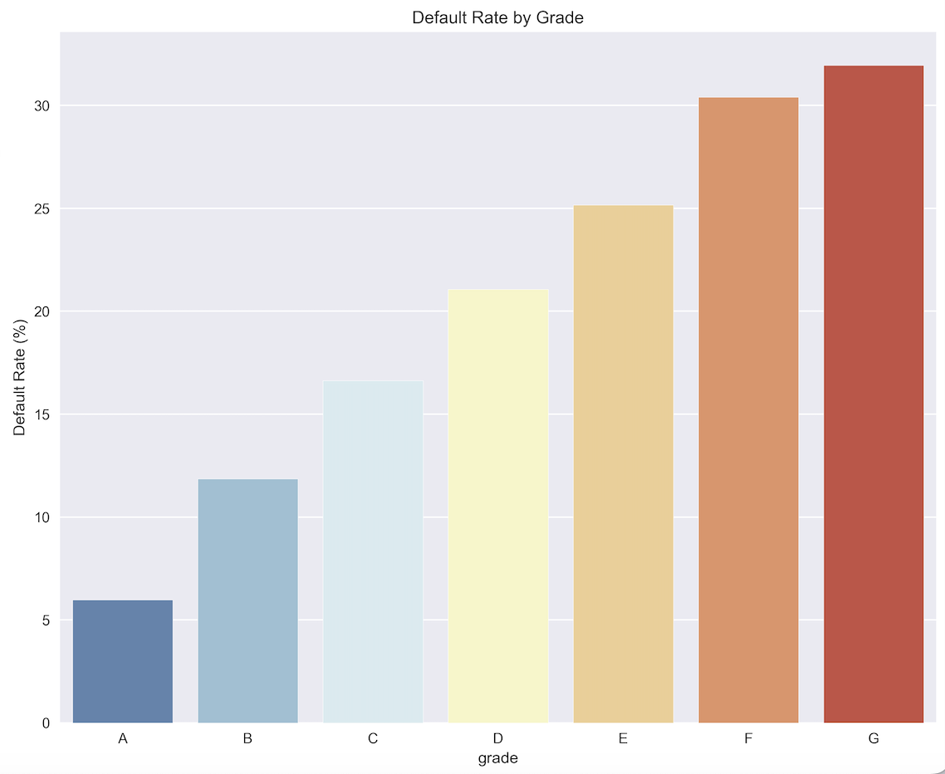
Loan Default Analysis
Default Rates by Income & Grade
- Grade A, High Income: 2.92%
- Grade A, Low Income: 9.75%
- Grade G, High Income: 21.37%
- Grade G, Low Income: 59.26%

Slide 10
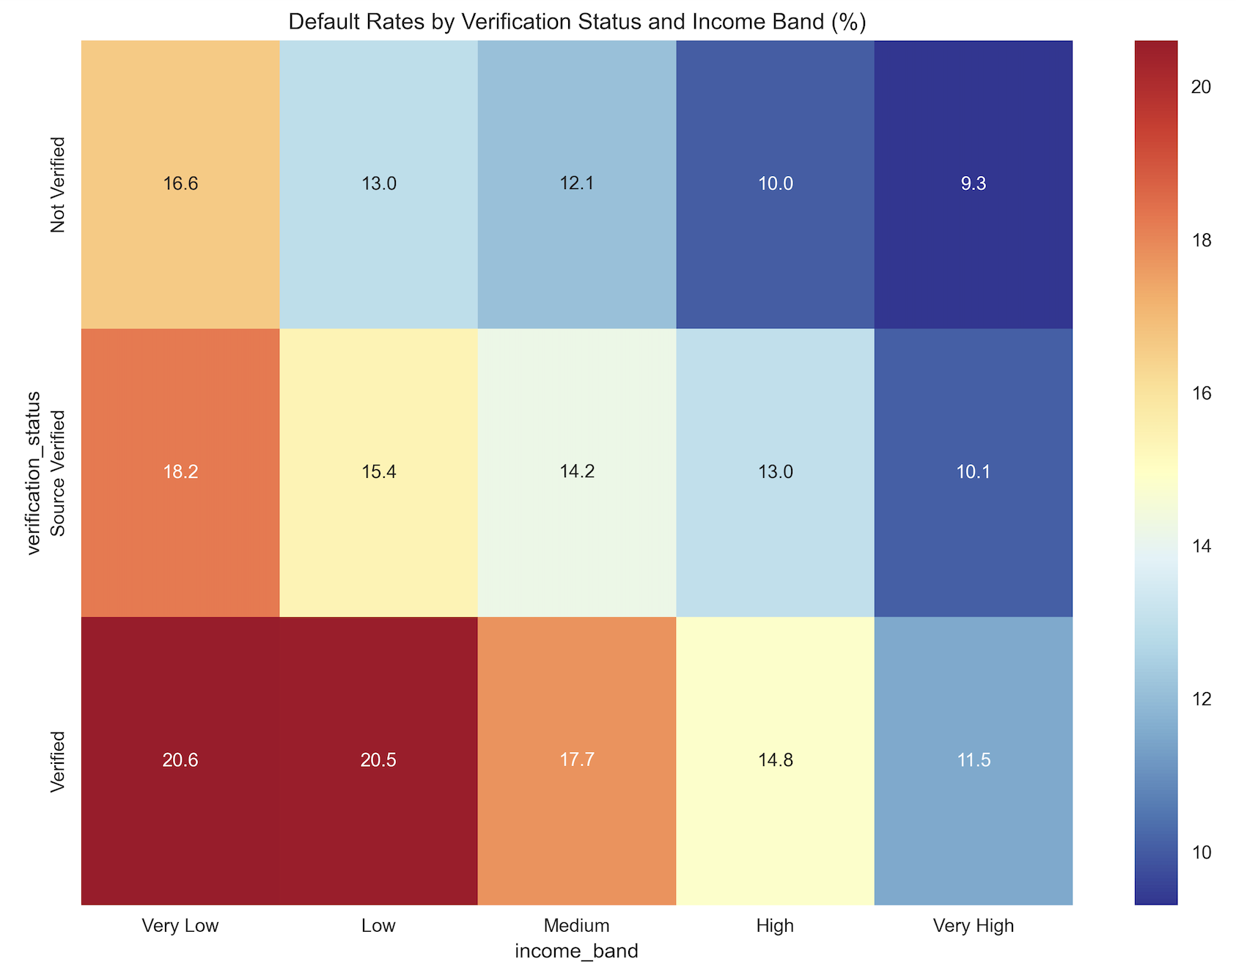
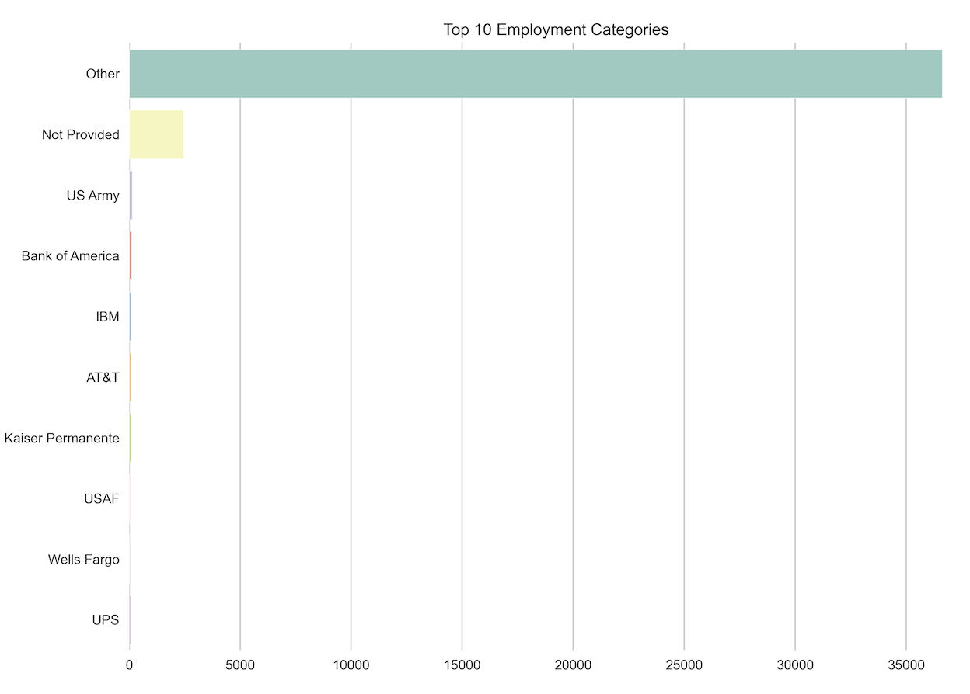
Loan Distribution and Default Rates
Default Rates by Verification
KYC – Employment Category
Default Rates are higher for Verified Customers for very low income band.
Need to Review & Enhance verification process
emp_title column is clear not enough to establish customer’s work background.
Data needs to be cleaned up to use customer’s employee’s industry name.

Slide 11
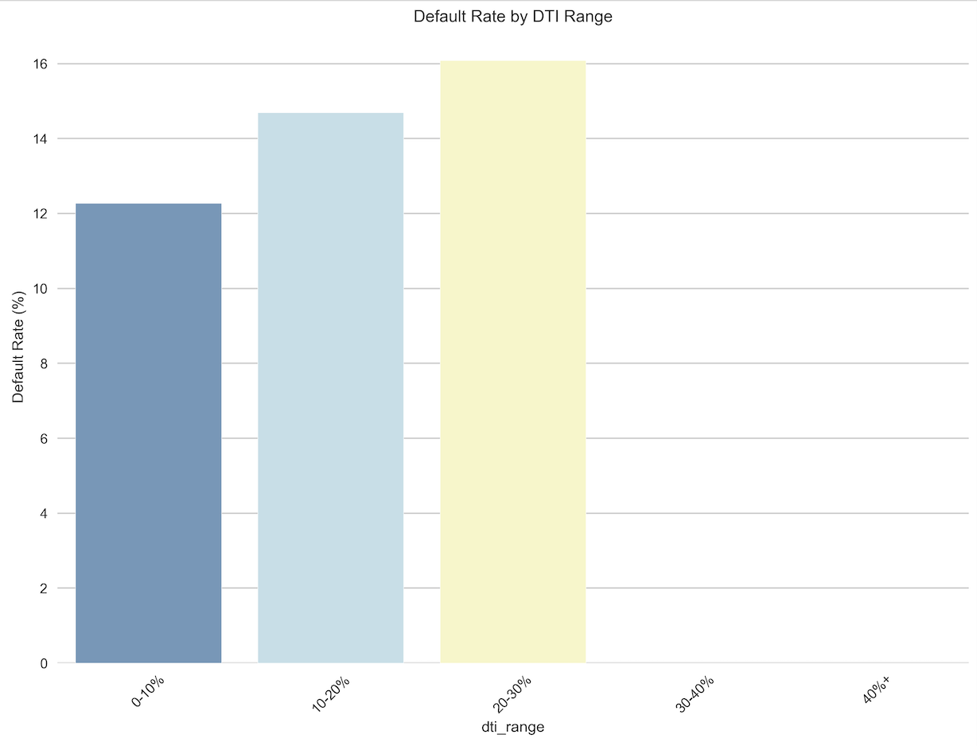
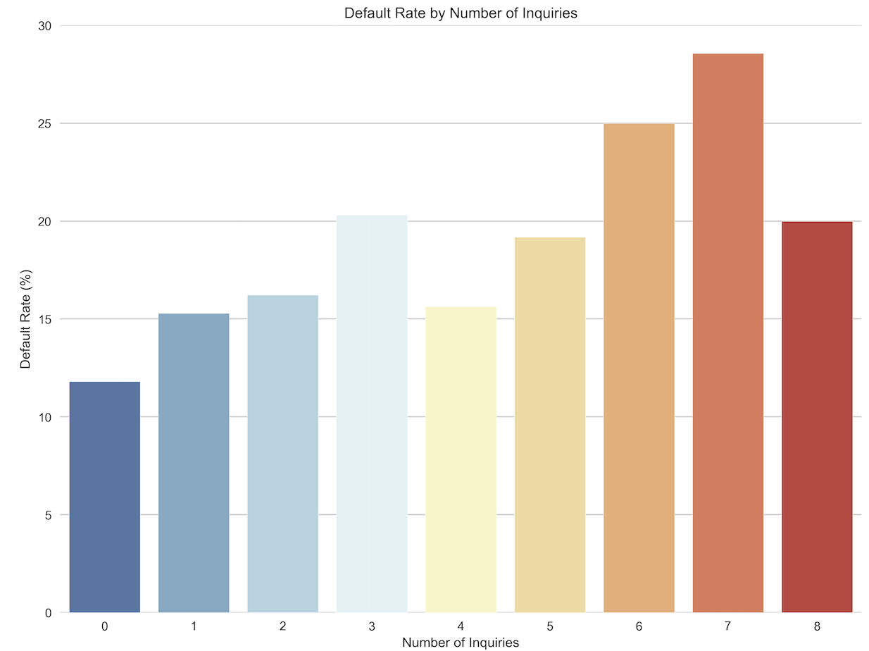
Credit Profile Analysis
Risk Indicators
Key Metrics
- DTI Ranges:
- 0-10%: 12.28% default
- 10-20%: 14.69% default
- 20-30%: 16.09% default
- Credit Inquiries Impact:
- 0 inquiries: 11.81%
- 3+ inquiries: 20.31%
- Principal Received: $389.0M
- Interest Received: $89.9M
- Recovery Rate: 5.55%
- Collection Fees: $492.7K

Slide 12
Key Indicators
Critical Insights
1. Income-Grade Correlation:
- High income reduces default risk across grades
- Strongest effect in higher risk grades
2. Geographic Opportunities:
- Texas outperforms on risk metrics
- Florida needs underwriting review
3. Purpose-Based Performance:
- Wedding loans outperform
- Small business needs review

Slide 13
Strategic Recommendations
Action Items
1. Portfolio Optimization:
- Increase Grade A-B exposure
- Reduce small business lending
- Expand in Texas market
2. Risk Management:
- Implement income-based pricing
- Review verification process
- Enhance recovery strategies
3. Growth Opportunities:
- Expand wedding loan program
- Develop targeted products for high-income segments
- Focus geographic expansion in strong-performing markets

Slide 14
Implementation Roadmap
Priority Actions :
Phase 1: Risk Adjustments
- Update pricing models
- Revise underwriting criteria
- Implement new scoring models
Phase 2: Product Development
- Launch enhanced wedding loans
- Develop high-income products
- Geographic expansion plan
Phase 3: Process Improvement
- Recovery process enhancement
- Verification system upgrade
- Risk monitoring tools

Slide 15
Appendix
Supporting Data:
Reference Sites : Consumer Financial Protection Bureau : https://www.consumerfinance.gov
Office of Financial Research : https://www.financialresearch.gov
ProjectHub : https://www.projectionhub.com/
Supporting Data:
- Detailed default rates
- Geographic breakdowns
- Income band analysis
- Term performance data

